Slide 1
Basic reproduction number for endemic diseases and seroepidemiology
Cristina Lanzas
CBS 810 Infectious disease modeling

Slide 2
Learning objectives
Explain how serology data can be used to estimate disease parameters
Calculate the force of infection and basic reproduction number from seroprevalence data
Analyze age-specific serological data to estimate age-specific force of infections

Slide 3
Timeline of infection
Keeling and Rohani, 2008

Slide 4
Immunity
Host immunity following exposure to a pathogen can last:
lifelong (e.g. measles)
a few years (e.g. influenza)
not at all (e.g. gonorrhea)
Immunity can also be partial – i.e. not full protection from subsequent infection or disease.
S
I
R
S
I
R
S
I
S
I
R

Slide 5
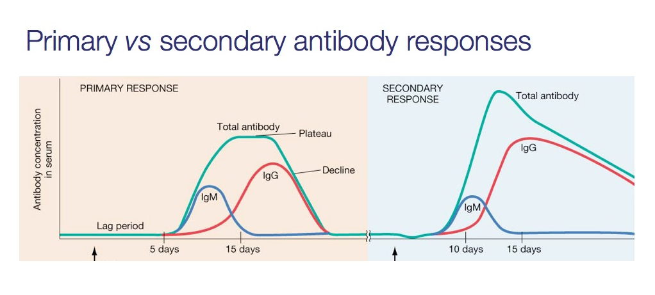
Antibody response
http://nfs.unipv.it/nfs/minf/dispense/immunology/lectures/files/somatic_hypermutation.html

Slide 6
Use of serological data
Determine disease incidence
Seroconversion
IgM response
Paired samples to detect IgG
Seroprevalence
Cut-off point that indicates past exposure
Cross-sectional age-stratified survey

Slide 7
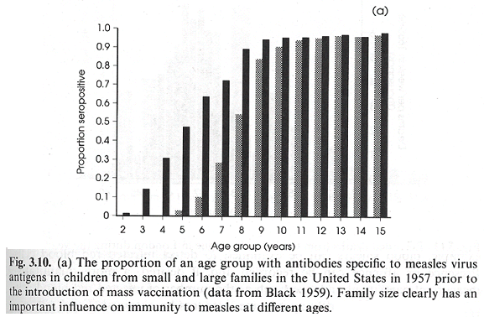
Seroprevalence profiles for measles in small (grey) and large (black) families
Anderson and May, 1992

Slide 8
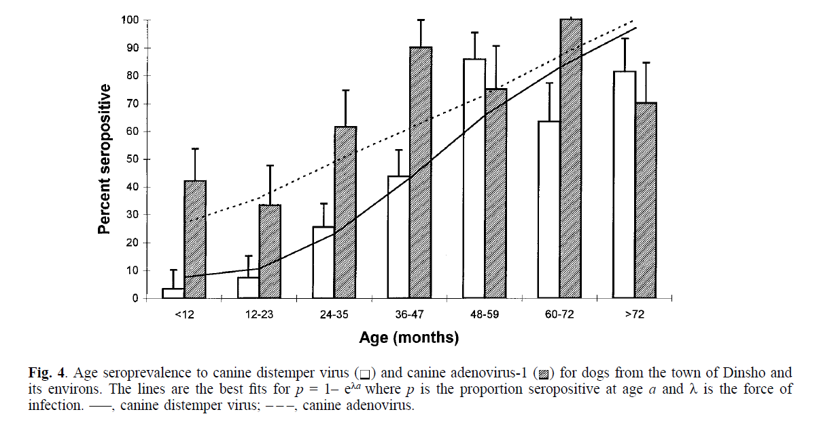
The proportion of individuals with antibodies increases with increasing age

Slide 9
Cross-sectional serological data for mumps in UK

Slide 10
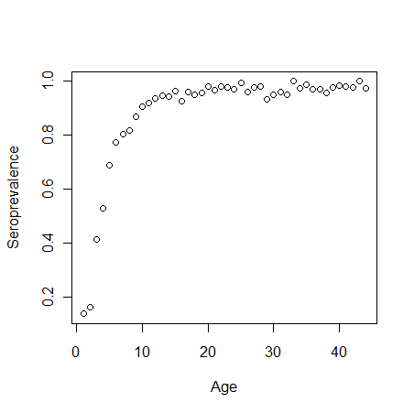
setwd("C:/Users/clanzas/Documents/R files“)
mumps=read.csv("Seroprofilemumps.csv",header=T)
## Create new variables in the dataframe mumps
mumps$seroprevalence=mumps$Seropositive/(mumps$Seropositive+mumps$Seronegative)
### plot proportion of (ever) infected (i.e., seroprevalence) as function of age
plot(mumps$Age,mumps$seroprevalence,xlab='Age',ylab='Seroprevalence')

Slide 11
Estimating the average force of infection from cross-sectional serological data: Catalytic model (Muench, 1934)
Susceptible s(a)
(Ever) infected z(a)
The proportion of individuals that are susceptible at age a, s(a) is:
s(a)=e^{-λa}
The proportion of individuals who have ever been infected by age a is given by :
z(a)=1-e^{-λa}

Slide 12
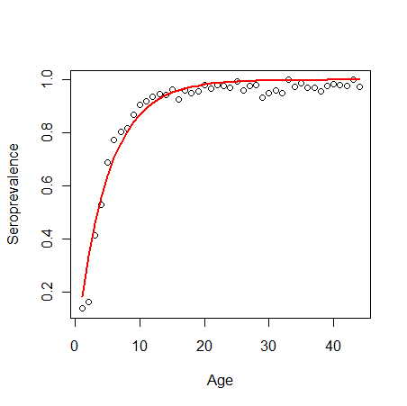
Fitting the model to the seroprevalence data
model=nls(seroprevalence~1-exp(-lambda*Age),data=mumps,start=list(lambda=0.40))
Formula: seroprevalence ~ 1 - exp(-lambda * Age)
Parameters:
Estimate Std. Error t value Pr(>|t|)
lambda 0.203718 0.007357 27.69 <2e-16 ***
Average age to infection (A) ~ 1/λ

Slide 13
Average age to infection
Average age to infection (A) ~ 1/λ
A for mumps = 1/0.204 ~ 5 years
Why measles and mumps are called childhood diseases?

Slide 14
Endemic SIR model
Assumes homogeneous mixing among all individuals of the population

Slide 15
Equilibrium states
,
Identify all possible solutions to one equation, we start with di/dt=0
i=0 ,Disease-free equilibrium
s*= (γ+υ)/β, so if s*=1/R_{0.}
Plug each possible solution into the remaining equations and repeat until all equilibrium values for all variables are identified, s, i and r at equilibrium are:

Slide 16
Derive an additional expression for the proportion of susceptible at endemic stage
Force of infection (λ) is the per capita rate of transmission (βi)
There is a constant average force of infection (λ) which remains approximately constant across ages (i.e., the force of infection is age-independent).

Slide 17
Basic reproduction number using seroprevalence data
Formula: seroprevalence ~ 1 - exp(-lambda * Age)
Parameters:
Estimate Std. Error t value Pr(>|t|)
lambda 0.203718 0.007357 27.69 <2e-16 ***

Slide 18
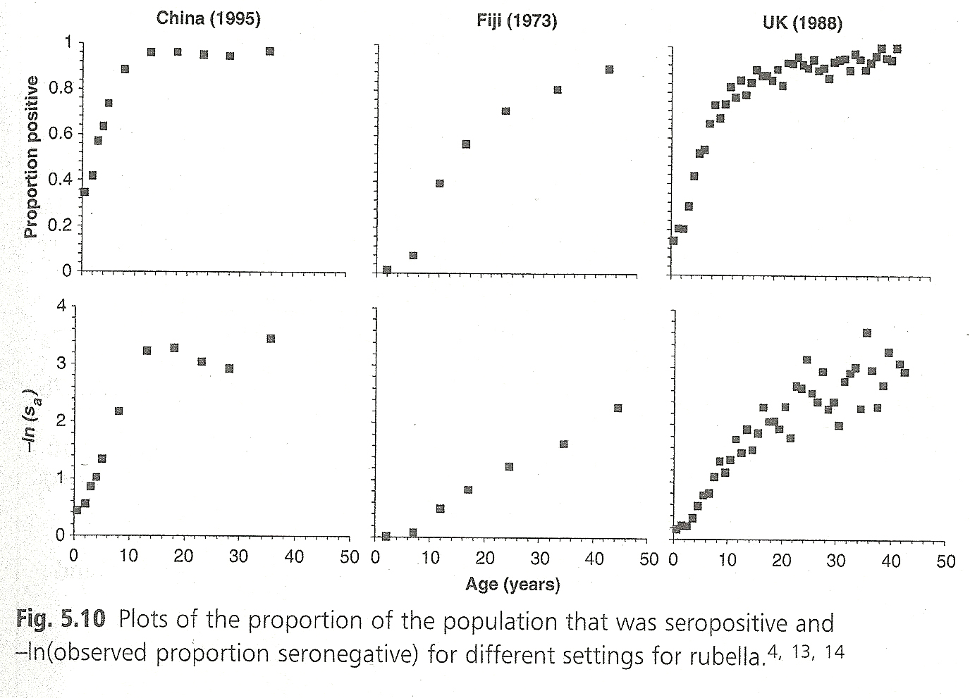
Age-dependent force of infection

Slide 19
Differences on the force of infection between children and adults
Differences on exposure to infection because of difference on contact patterns (schools)
Differences on susceptibility between children and adults
Genetic factors (the most susceptible individuals become infected at a younger age)

Slide 20
Age-dependent force of infection
μ
μ
γ
β
γ
β
S
S
Sc
I
I
Ic
R
R
Rc
μ
l
μ
l
μ
l
γ
γ
S
S
Sa
I
I
Ia
R
R
Ra
μ
μ
μ
μ
μ
μ

Slide 21
Age-dependent force of infection
Age-structured models usually group individuals into a limited number of classes-often representing school years
Note: dR/dt equations are omitted

Slide 22
WAIFW matrix (Who Acquires Infection From Whom)
To estimate from the cross-sectional serological data, we need to reduce the number of unknowns to 2, for example:

Slide 23
Configuration options for WAIFW matrix
To estimate from the cross-sectional serological data, we need to reduce the number of unknowns to 2, for example:

Slide 24
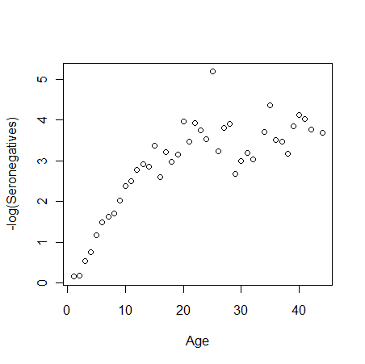
Age-dependent force of infection

Slide 25
Age-dependent force of infection
If we consider that the force of infection is constant but different among the two age groups:
0 ≤ a < a_{y}
s(a)=
a_{y} ≤ a ≤ L

